Slide 1
Data Structures and Algorithms (Introduction)
Abdul Karim Shahid
akarim@cuilahore.edu.pk
26-Block H
Department of Computer Science

Slide 2
Data Structure
In computer terms, a data structure is a Specific way to store and organize data in a computer's memory so that these data can be used efficiently later.

Slide 3
Data Structure
Types of Data Structure (DS)
Primitive DS
No-Primitive DS
Integer
Float
Character
Boolean
Linear DS
Non-Linear DS
Arrays
Linked List (LL)
Stack
Queue
Trees
Graphs
Single LL
Double LL
Circular LL
Binary
Binary Search Tree

Slide 4
Data Structure
Types of Data Structure (DS)
Primitive DS
No-Primitive DS
Integer
Float
Character
Boolean
Linear DS
Non-Linear DS
Arrays
Linked List (LL)
Stack
Queue
Trees
Graphs
Single LL
Double LL
Circular LL
Binary
Binary Search Tree
Common Operations:
Insertion: This operation refers to the addition of a new data element into the DS.
Deletion: Delete or remove an existing data element from the DS.
Traversal: Process and display all the data elements in the DS.
Searching: Search for a specific data element in the DS.
Sorting: Arrange all the data elements in the DS either in ascending or descending order or any other logically sequential order.
Updating: This operation refers to changing existing data elements with new values in the DS.

Slide 5
Types of Data types
Primitive data type – These data types are also referred to as fundamental data types. These are pre-defined data types and convey a specific meaning to the compiler. For example int, float, char, string, double, etc.
Non-primitive data type – These data types are composed of primitive data types. These are also referred to as user-defined data types as they are not pre-defined by the compiler. For example arrays, structures, class, linked lists, etc.

Slide 6
Algorithms
An ordered sequence of very clear and defined steps that aim to solve the problem

Slide 7
Algorithm
The order of the actions in an algorithm is important
Example: algorithm to go to work every morning
Get out of bed;
Take a bath;
Get dressed;
Eat breakfast;
Take the bus to work.
If I carry out the same actions in a different order
Get out of bed;
Get dressed;
Take a bath;
Eat breakfast;
Take the bus to work.
Then, I will still get to work, however soaking wet
So order is important

Slide 8
Pseudo Code and Flowchart
Pseudo codes (an informal way of programming description that does not require any strict programming language syntax or underlying technology considerations.)
Flowcharts(A flowchart is the graphical or pictorial representation of an algorithm with the help of different symbols, shapes, and arrows to demonstrate a process or a program.)

Slide 9
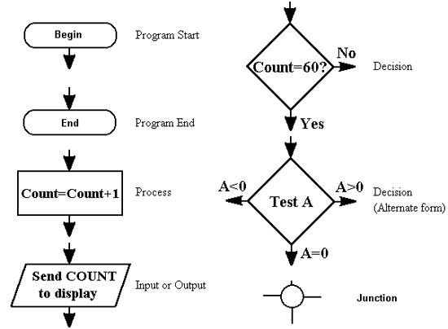
Flow chart Symbols
Flow Lines
Connectors
Flow Lines
Connectors

Slide 10
Pseudo Code
Example: The following set of instructions forms a detailed algorithm in pseudo-code for calculating the payment of person.
Begin
Input the three values into the variables Name, Hours, Rate.
Calculate Pay = Hours * Rate.
Display Name and Pay.
End

Slide 11
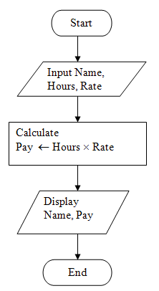
Flowcharts

Slide 12
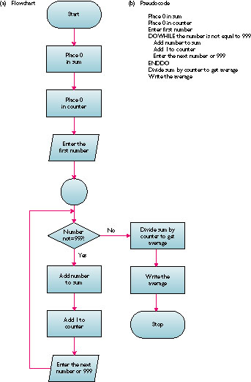
Flow Chart another Example
(b) Pseudo code
Place 0 in sum
Place 0 in counter
Enter first number
DOWHILE the number is not equal to 999
Add number to sum
Add 1 to counter
Enter next number or 999
ENDDO
Divide sum by counter to get average
Write the average
Accept series of numbers and display the average

Slide 13
Software Attributes
Good software
Efficient code
Maintainable
Easy to modify existing functionality
Cost of changes is minimal
Changes should be local in effect

Slide 14
Data Structures
Efficient processing.
Organized data.

Slide 15
Efficiency Estimation
Time Complexity
Space Complexity

Slide 16
Efficiency Estimation
We can consider each statement as a single step
To count total number of steps
Step count for each statement
Frequency of each statement
Finally sum these counts to get the total step count

Slide 17
Efficiency Estimation
Statement | S/e | Frequency | Total Steps
float sum (float list[], int n) | 0 | 0 | 0
{ | 0 | 0 | 0
float temp = 0; | 1 | 1 | 1
int i; | 1 | 1 | 1
for (i=0; i<n; i++) | 1 | n+1 | n+1
temp+=list[i]; | 1 | n | n
return temp; | 1 | 1 | 1
} | 0 | 0 | 0
Total |  |  | 2n+4

Slide 18
Asymptotic Notations
Notations to analyze an algorithm on how it performs when given a certain input.
Types of notations:
Big-O (Big O) [Atmost or Upper Bound]
Big-Ω (Big-Omega) [AtLeast or Lower Bound]
Big-θ (Big Theta) [Range or Tight Bound]

Slide 19
Big-O (Big O)
This notation is used to define the upper bound of an algorithm or define the worst case of an algorithm.
Big-O has several notations:
Constant - O(1)
Linear - O(n)
Quadratic - O(n²)
Exponential - O(2^{n})
Logarithmic - O(log(n))
Factorial - O(!n)

Slide 20
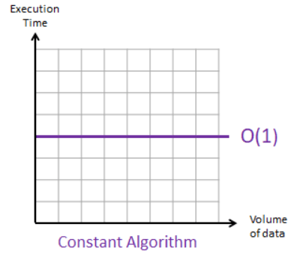
Big-O (Big O)
This notation is used to define the upper bound of an algorithm or define the worst case of an algorithm.
Big-O has several notations:
Constant - O(1):
It means that no mater what the input size be, the execution time will always be the same.
Example:
item = items[0]

Slide 21
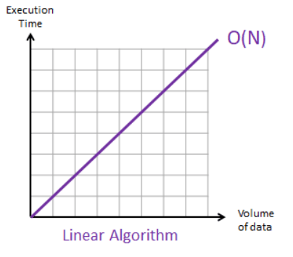
Big-O (Big O)
This notation is used to define the upper bound of an algorithm or define the worst case of an algorithm.
Big-O has several notations:
Linear - O(n)
It means that the execution time is in direct propotion to the input i.e. if the input size increases or decreases so does the execution time increases or decreases.
Example:
element_found = [x for i,x in ([2,3,5]) if x==5]
In the above example searching an element in a linear search manner.

Slide 22
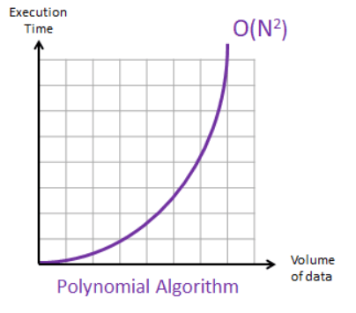
Big-O (Big O)
This notation is used to define the upper bound of an algorithm or define the worst case of an algorithm.
Big-O has several notations:
Quadratic - O(n²)
It means that the execution time of an algorithm is directly proportion to the square of the size of the input.
Example:
for i in [2,3,4,5]:
for z in [5,4,3,2]: print(f"Match {z}") if i == z else ''
Above example has nested loop which makes it a quadratic operation.

Slide 23
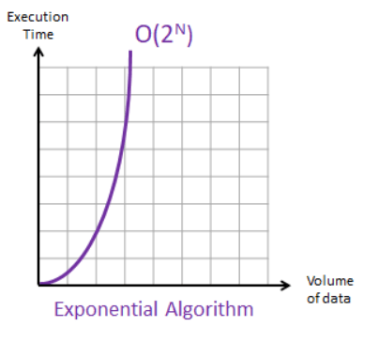
Big-O (Big O)
This notation is used to define the upper bound of an algorithm or define the worst case of an algorithm.
Big-O has several notations:
Exponential - O(2^{n})
It means the execution time will double with each additional element in the input set.
Example:
def fibonacci(n): if n <= 1: return n else: return((fibonacci(n-1) + fibonacci(n-2)))

Slide 24
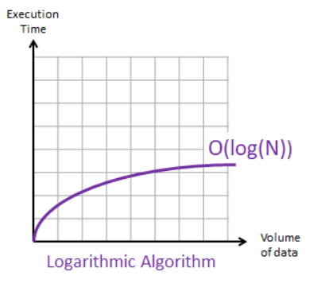
Big-O (Big O)
This notation is used to define the upper bound of an algorithm or define the worst case of an algorithm.
Big-O has several notations:
Logarithmic - O(log(n))
If an algorithm solves the problem by dividing it into half each time then its a O(log n). A great example of it is Binary Search Algorithm.

Slide 25
Big-O (Big O)
This notation is used to define the upper bound of an algorithm or define the worst case of an algorithm.
Big-O has several notations:
Factorial - O(!n)
Is an algorithm which tries all the permutation of a given input array. Its one of the worst performing algorithm hence you don't want your algorithm to be to this level.
Example:
Most commonly talked about factorial complexity algorithm is Travelling Salesman problem when does using Brute force method, where all the possible path combinations are evaluated. Another example is to get the factorial of a number.
def factorial(n): for i in
(n): factorial(n-1)
Outer loop is O(n), inner function is called recursively with (n-1) you get n * (n-1)* (n-2)*...*1 = n! so the function is O(n!).

Slide 26
Complexity
Algorithm | Data structure | Time complexity:Best | Time complexity: Average | Time complexity:Worst | Space complexity: Worst
Quick sort | Array | O(n log(n)) | O(n log(n)) | O(n²) | O(n)
Merge sort | Array | O(n log(n)) | O(n log(n)) | O(n log(n)) | O(n)
Heap sort | Array | O(n log(n)) | O(n log(n)) | O(n log(n)) | O(1)
Smooth sort | Array | O(n) | O(n log(n)) | O(n log(n)) | O(1)
Bubble sort | Array | O(n) | O(n²) | O(n²) | O(1)
Insertion sort | Array | O(n) | O(n²) | O(n²) | O(1)
Selection sort | Array | O(n²) | O(n²) | O(n²) | O(1)
Bogo sort | Array | O(n) | O(n n!) | O(∞) | O(1)

Slide 27
Complexity
Data structure | Time complexity |  |  |  |  |  |  |  | Space complexity
 | Avg: Indexing | Avg: Search | Avg: Insertion | Avg: Deletion | Worst: Indexing | Worst: Search | Worst: Insertion | Worst: Deletion | Worst
Basic array | O(1) | O(n) | — | — | O(1) | O(n) | — | — | O(n)
Dynamic array | O(1) | O(n) | O(n) | — | O(1) | O(n) | O(n) | — | O(n)
Singly linked list | O(n) | O(n) | O(1) | O(1) | O(n) | O(n) | O(1) | O(1) | O(n)
Doubly linked list | O(n) | O(n) | O(1) | O(1) | O(n) | O(n) | O(1) | O(1) | O(n)
Hash table | — | O(1) | O(1) | O(1) | — | O(n) | O(n) | O(n) | O(n)
Binary search tree | — | O(log (n)) | O(log (n)) | O(log (n)) | — | O(n) | O(n) | O(n) | O(n)
B-tree | — | O(log (n)) | O(log (n)) | O(log (n)) | — | O(log (n)) | O(log (n)) | O(log (n)) | O(n)
Red-black tree | — | O(log (n)) | O(log (n)) | O(log (n)) | — | O(log (n)) | O(log (n)) | O(log (n)) | O(n)
AVL tree | — | O(log (n)) | O(log (n)) | O(log (n)) | — | O(log (n)) | O(log (n)) | O(log (n)) | O(n)

